Slide 1
Texas Laptop Case
For Good Computing
Chuck Huff and William Frey
Materials assembled by Nathan DeWall

Slide 2
Texas: Laptops to Students
The computer revolution has placed pressure on public educators to provide students with up to date technology intensive instruction.
In the late 20th century, the Texas State Legislature responded with two initiatives.
They expanded the definition of textbook to include electronic media.
They called for a study into the feasibility of having students public students lease laptops
The Texas Laptop project failed to go beyond pilot project phase.
Teacher and parent opposition
Lack of technical support
Lack of support from publishing houses and computer vendors

Slide 3
Texas Laptops
Social Inequities: Some school districts provide better education than others
Edgewood Case
1967—Edgewood school district sues Texas for inadequate and unequal funding
1987—Federal court mandates that Texas develop more equitable funding structure for schools
Revenue Problem
State funding options are limited to property and sales taxes. (Rejected bonds and income tax)
No state income tax, no state lottery to provide education funds
Increasing property or sales taxes constitutes political suicide and raises issues of social justice

Slide 4
PR Laptops to Teachers
In Puerto Rico, a project to give laptop computers to public school teachers also ran into difficulties.
Training programs encountered teacher resistance, lack of technical support and poor infrastructure.
Attempts to control laptop use also generated teacher resistance and non-participation.
Bidding irregularities generated considerable adverse publicity

Slide 5
MIT laptops
Jump start education in developing nations.
Buy two; keep one and have the other donated.
Lack of government support in developing nations
Problems:
Are laptops designs safe for children?
Is this the most efficient use of scarce educational funds?
How can students use computers with lack of supporting infrastructure?

Slide 6
Laptops: Hardware and Software
Laptops are made of toxic materials
Processors and screens: Lead, Mercury, Cadmium
Batteries
Nikel, Cadmium, Lithium
Sugar Software
Open source software that is publicly accessible
But difficult to install
MIT Laptops
Hand cranks to recharge batteries

Slide 7
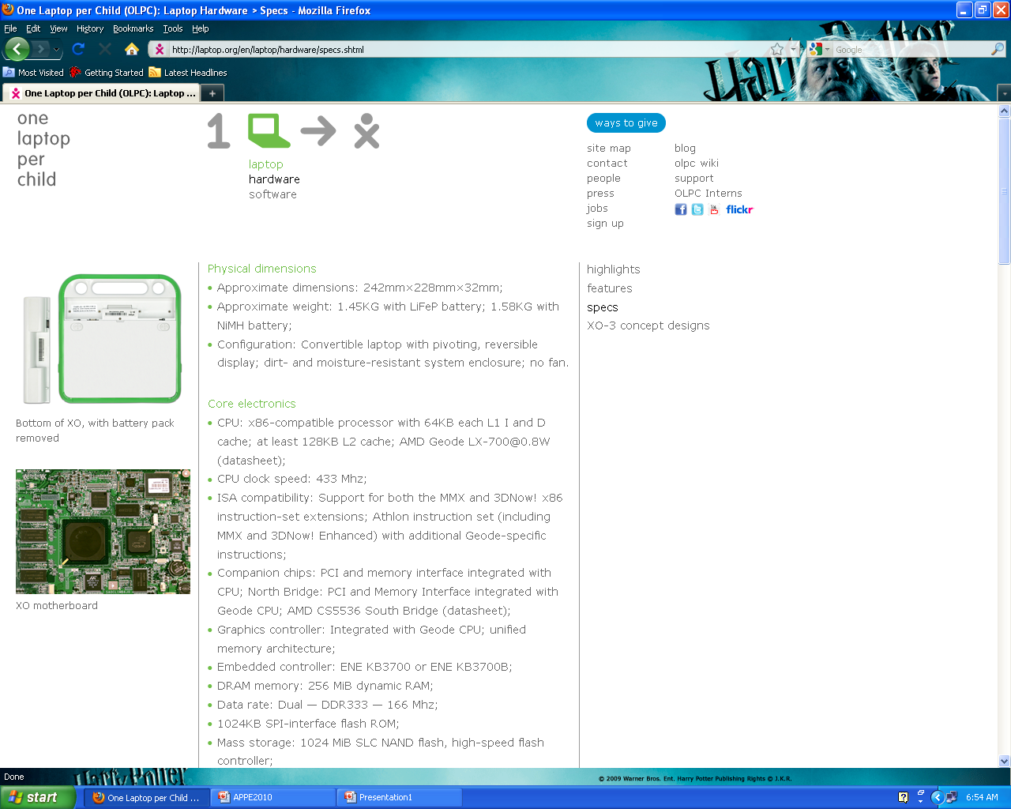

Slide 8
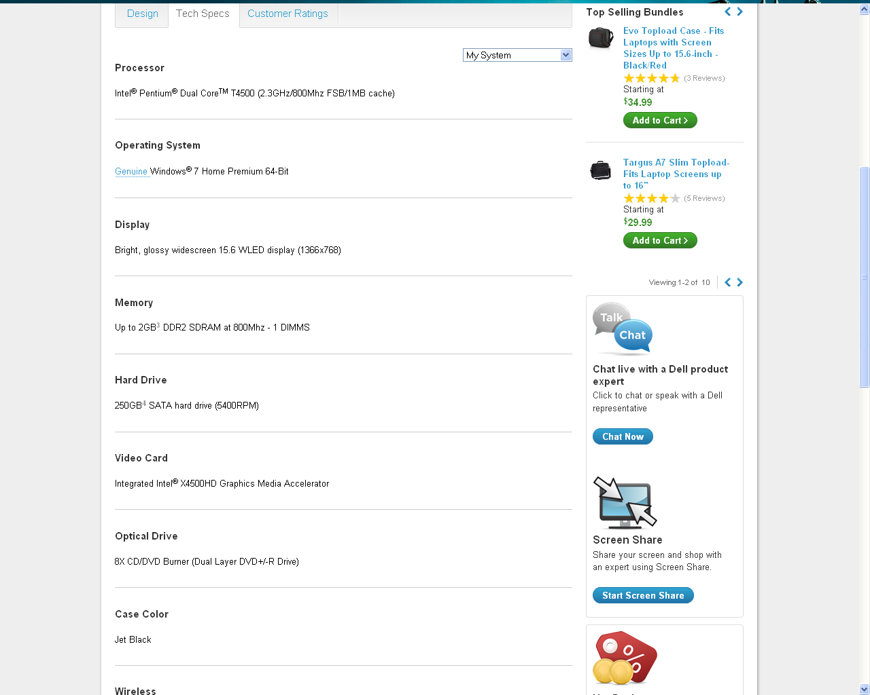

Slide 9
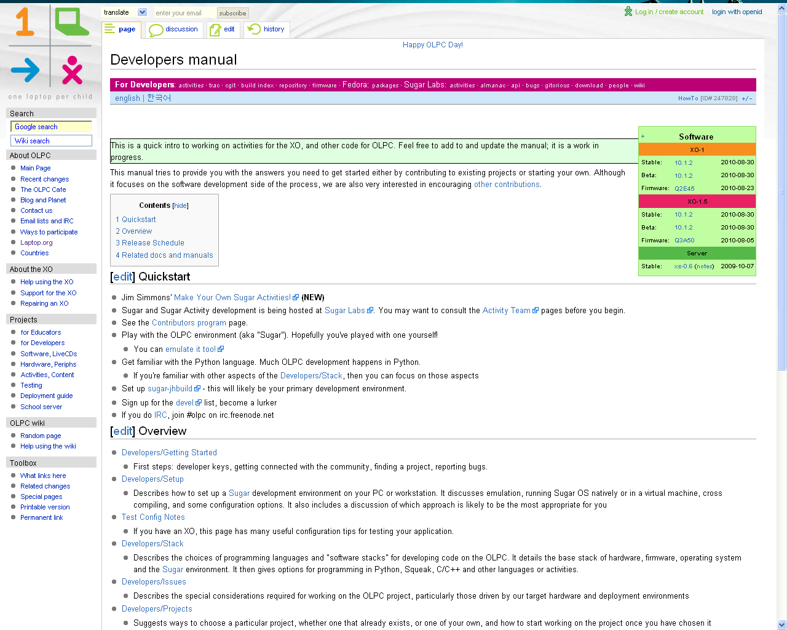

Slide 10
Pedagogy/ Technology | Technology Free | Technology Integrated
Teacher Centered | Traditional classroom with teacher zone facing student zone | Teacher zone and student zone with traditional teaching activities supported by technology
Student Centered | Traditional classroom with distinction between teacher and student zone softened or eliminated | Student learning centers fully equipped with hardware and software

Slide 11
Stakeholders
Students
Interests: receiving a good education (career, social skills, civic virtues)
Role: Laptop Users
Teachers
Interests: academic freedom; livelihood; technical and administrative support
Role: providing students with a good eduction
Independent School districts
Interests: generating funds ; delivering quality education
Role: administering schools according to needs of society
Textbook Providers
Interests: continued revenue stream from books; protecting copyrights;
Role: providing quality textbooks; lobbying state officials

Slide 12
Stakeholders
Computer Venders
Interests: fair bidding process; continued profits
Role: Sell, and provide technical support, for laptops
Digital Medium Developers
Interests: Market access and profits; academic freedom; livelihood; technical and administrative support
Role: providing quality digital textbooks and materials at affordable price

Slide 13
Procedures
Legislative Procedures
Promoting, funding, and integrating educational technology
Defining and selecting textbooks
Defining curriculum content
Fund Raising Options for governments
Bond Issues
Sales Taxes (Flat)
Income Taxes (Progressive)
Property Taxes
Foreign Policy Initiatives to respond to global inequities like digital divide
Bidding Procedures (computer venders)
Technical criteria
Bidding Process (secrecy)

Slide 14
Laws and Regulations
Copyright (textbooks)
Patents (inventing new laptop designs)
Civil Law (if children are harmed by using computers)
Environmental Law and Regulations governing the manufacture, use, and disposal of computers
Court decisions designed to enforce equality between school districts

Slide 15
Information and Information Systems
Internet security and supporting hardware and software features
Anti-virus programs, firewalls, etc
Issues of restricting access to certain websites
Information that students are allowed to enter and store in computers
Keeping information secure in all phases: entry, storing, transferring, destroying
Storage Media, strengths and vulnerabilities

Slide 16
Key Value Points
Safety
Procedures (training students how to use laptops)
Hardware design
Security
Software (blocking pornographic websites)
Physical surroundings (walking to and from school)
Reliability
Designing durable and lasting hardware and software components
Justice
Reducing computer costs; Open Source Operating System
Computers in developing nations
unreliable electricity, humidity, infrastructure (telephones, broadband, wireless)
Responsibility
Teaching responsible computer use to children
Identifying age level capable of responsible use

Slide 17
The Debate in Texas
Proposed Advantages
vehicle for presenting the new electronic textbooks
effective means for educating current generation of wired students
solves problem of digital divide—all students have access to computers at home and at school
graduates computer literate students
provides personalized instruction through effective software

Slide 18
The Debate in Texas
Emerging Disadvantages
Is it really cost effective?
Will publishing companies go along with digitalization of textbooks?
Is it really equitable?
Leasing fee burdens poor students in poor districts
Is it really education?
Or is it edu-tainment?

Slide 19
Debate among education specialists: Larry Cuban
Teachers do not participate in software development yet educational software is value laden
Does forcing them to use it violate their academic freedom
Teacher training and technical support represent hidden problems and costs
Focuses education on the accumulation of information when the real task is to teach the skills that convert information into knowledge
Works well in some areas (drill exercises in math) but fails to promote two of the three aims of education
Career
Social skills
Civic virtues: “habits of the heart” (Alexis de Tocqueville)

Slide 20
Ethical Issues
Justice (in the form of equity and access
Can laptops lessen the “digital divide” between children in richer and poorer educational districts?
Digital Divide in Texas and PR (rich vs. poor school districts)
Larger digital divide addressed by MIT Project (rich vs. poor nations)
Environmental Harm
Exporting Harm to Developing Nations (Greenpeace Video)
Social Injustice

Slide 21
Questions on Equity and Access
Can all students afford lease?
Wealthy districts already have a head start
Students with access at home

Slide 22
Studies by UPRM Students
One study investigates teacher attitudes to integrating computer technology into the classroom
They would like to publish their own material online but are uncomfortable with copyright issues
Another group rejected the laptop approach preferring, instead, to establish computer laboratories at school

Slide 23
Exporting Harm
Two groups interviewed the Caribbean Hi-Tech Recyclers in Guanica, Puerto Rico
Saw Green Peace video about exporting harm
Spent computer sent to developing nations in Asia and Africa where the precious metals are harvested under dangerous conditions.
Two solutions
Government-private industry partnership to develop comprehensive computer disposal program. Paid for by surcharge on computers at point of purchase
Redesigning computers for recycling and for child use. Anticipated the MIT Laptop project

Slide 24
Educational Laptop Decision Points
Selecting and purchasing laptops
One Laptop Per Child
OLPC Parents
Social Justice Cases from Dominican Republic
Obsolete Textbooks or No Textbooks?

Slide 25
Decision Point 1
You are a computer engineer and have been subcontracted by your local government to purchase new portable computers for high school teachers. Your job includes…
selecting the kind of computer to be used
identifying vendors who will sell you the computers
overseeing the distribution of computers to high school teachers
developing and implementing a training program to help teachers learn to use computers
designing a technical support hotline to help teachers work through the problems that arise

Slide 26
Decision Point 1 Continued
Distributing computers to high school teachers seems simple enough. You select the computers, buy them, and give them to the teachers. Yet only a slight change in circumstances can bring into the open latent or potential ethical issues:
How should you go about selecting the computers for the teachers?
What should you do to identify their needs? Would you find the computers and the software you selected acceptable if you were in their place? How do you successfully put yourself in the place of those who will be affected by your actions and decisions? (For example, you are comfortable using computers. But how do you understand and respond to those who find computers strange, exotic, or intimidating?)
Who stands to benefit from or be harmed by your actions?
Does your decision disproportionately benefit (or harm) anyone? Do some reap the benefits of your actions while others bear the harms?

Slide 27
Decision Point 1 Continued
Latent ethical issues often arise when events take a certain line of development. Consider these four slight changes in circumstances:
Someone you knew well—say, your cousin—submits a bid. What ethical issues does this turn of events give rise to?
The contract to provide computers is awarded to your cousin, and he provides reliable computers at a reasonable price. Then, a few weeks later, you read the following headline in the newspaper: “More Government Corruption—Computer Tsar’s Cousin Reaps Millions in Cozy Computer Deal.” What should you do?
A group of angry high school teachers holds a press conference in which they accuse the government of forcing them to use computing technology in their classes. They say you are violating their academic freedom. How should you respond?
Someone in the government suggests placing a program in each computer that allows law enforcement officials to monitor the computers and track user behavior. How would you feel if your computer use were being monitored without your knowledge or consent? Are there circumstances under which monitoring could bring about any social benefits? What are the likely harms? Do the benefits outweigh the harms? Suppose you go along with this and read the following headline in the morning newspaper: “Government Snoops Bug High School Computers!” What would people think of you for going along with this? What would you think of yourself?

Slide 28
Decision Point 2 (MIT Laptops)
You are Dr. Negroponte from MIT. For several years now, you have been working to develop a laptop computer design that responds to a wide variety of needs for children in poor, developing nations.
For $300, individuals buy two laptop computers, one of which is donated to a child in a developing nation.
The computers display a simple design, use Linux software, and have a hand crank which can be used to recharge its battery. In this way, they can establish a wireless connection to the Internet even in areas with little or no electricity.
An Open Education Resource movement has made efforts to develop first rate educational material that is freely available on the Internet. Thus, the MIT laptops provide children and their teachers in developing nations access to materials freely available on the Internet instead of requiring that they (or their governments) pay considerable sums of money for textbooks.
There is evidence that laptops can and have contributed to an enhanced educational experience for children in developing nations. Poor attendance is a big problem and laptops have been shown to increase attendance and provide additional motivation to students to study. Because they promise to circumvent traditional obstacles to education, they have been embraced by teachers and international relief agencies.

Slide 29
MIT Laptops Continued
But recently, the laptop project has come under increasingly critical scrutiny.
They are more expensive that traditional educational materials such as textbooks.
They compete for scarce financial resources and may be less cost-effective than other more traditional educational resources.
The MIT laptop has no hard, a fact singled out by criticism by Bill Gates.
Designed to use Linux instead of Microsoft as their operating system. Why?
Several governments have verbally committed to adopting the MIT laptop but have yet to deliver with real action.

Slide 30
MIT Laptops Continued
Defend the MIT Laptop Project in the face of this and other criticism
Should the laptop design be modified to suit better the needs expressed through these criticisms.
How does the MIT Laptop already exhibit design features responsive to childrens’ needs
What are the alternatives to MIT Laptops?
Think high and low technology.
What are their advantages and disadvantages?

Slide 31
Decision Point 3: Laptop Parents
You live in a developing nation. While you have work, it doesn’t pay well and you are barely able to make ends meet.
Your child came home with an MIT-designed laptop computer. She and her classmates have benefited from computers donated to their school by the generosity of individuals in developed nations who have opted into the buy 2 laptops and have one donated to a need child like your daughter.
You quickly come to think of this donation as a mixed blessing. On the one hand, this laptop has helped you all to enjoy the benefits of the Internet, including the vast store of information it makes available. On the other hand you question whether your child is mature enough to use and protect her computer.
If anything should happen you would be required to replace it with your own funds, and you clearly cannot afford this. Yet your daughter would be unable to continue with her education without a computer.
Furthermore, laptops are designed for adults, not children. They contain heavy metals and other toxic materials. They also provide ready targets for robbers. Your daughter walks by herself to and from school and is, thus, vulnerable to robbery.
What should you do?

Slide 32
Social Justice Cases From DR
Case/Module | Description
Pipiota Enterprise, LTD | Balancing cost and environmental concerns in designing and constructing an oil refinery in the Dominican Republic
Ingenieria Santiago | An engineer is under pressure to present unrealistic price estimates in a bid which will later be “fixed” when the company gets the contract
Erick Carrasco’s Decision | Should an engineer accept confidential information from a disgruntled employee of a competitor?
A Decision for the Enc. De Asignación | An engineer discovers that an accepted bid is insufficient for carrying out the project
Providing Water to a Marginalized Community | Civil Engineers in the government must evaluate a poor community’s request for potable water. Among the considerations is who will pay for this service.
Scenario: Expensive Textbooks | How should professors make textbook decisions given the limited income of students?
Case in Industrial Psychology | Should an industrial psychologist involved in a job search inform candidates of potential dangers inherent in the job?
Working Yourself Out of a Job | An engineer becomes aware that if he carries out his job too well, he will become expendable.

Slide 33
Chair Debate: DR Textbook Case
You are a university professor. Your university is situated in an area of low income residents. Consequently, your students have little disposable income. Your course requires the use of an expensive textbook that the publishing company (and authors) frequently update. The updates are real and substantive. As a result, older editions are less expensive but obsolete. What should you do?.
Xeros the new textbook illegally.
Solicit permission to photocopy from the author (total or partial)
Do not use the textbook in your class. Find some other way. (What would this be?)
Use an older but obsolete edition of the textbook.
Generate your own material based on the content of the textbook.

